Slide 1


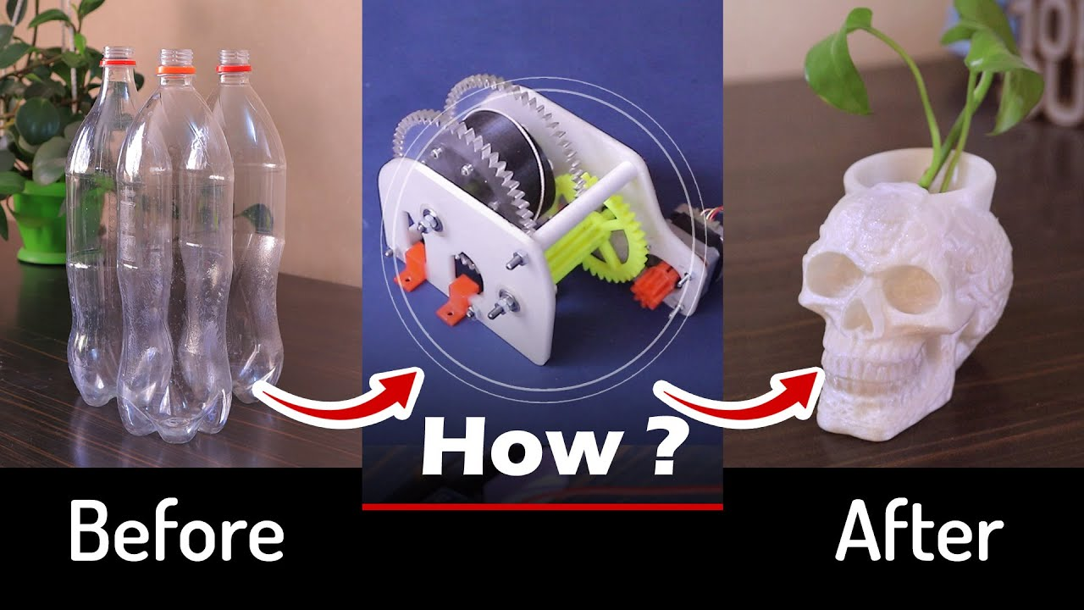
3D PRINTER FILAMENT MAKER
MOHAMMED SAAD SAYYED

Slide 2

ABSTRACT
The purpose of this project is to recycle the plastic bottle waste material into a useful filament by using an Filament maker machine. The study focuses on forming a new filament by using recycled Polyethylene Terephthalate (PET) from plastic waste. The recycled filament is then utilized to an open-source 3D printing to create a specimen. The investigation of its mechanical properties is done by comparing the tensile strength, tensile strain, maximum load, and modulus young to pure PET material data. The result shows the original PET specimen can withstand a 724N maximum load while recycled PET specimen can accept 713N.

Slide 3

CONTENT
INTRODUCTION
HISTORY
DIFFERENCE
COST ESTIMATE
ACTUAL EXERCISES
ASSEMBELY
PROBLEM FACED
MEDICAL APPLICATION
MARKET SURVAY
TESTING

Slide 4
WHAT IS FILAMENT MAKER
It is use to recycle the waste plastic bottle
It can convert the plastic bottle into 3d printer filament
It can reduce the cost of the production of model
It gives finishing like other filament

Slide 5
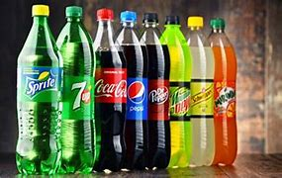
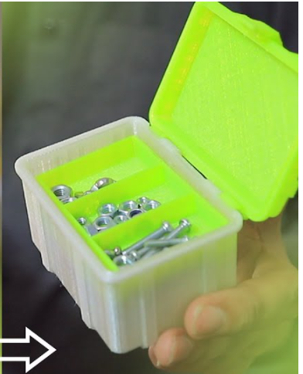
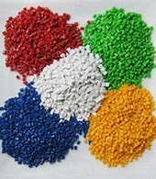
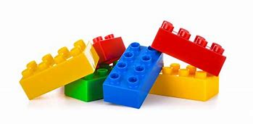
DIFFERENCE BETWEEN PET AND PLA , ABS ,
PET (Polyethylene Terephthalate )
ELECTRICITY BILL : 100 rs for 24 hr
ERROR COST : 10%
REUSE COST : 0%
STRENGTH : MODRATE
AVALABILITY : ANYWHERE MORE USEFULL FOR SMALL AND NON USED PRODUCT
PRODUCTION COST 50 RS / KG
ABS (Acrylonitrile Butadiene Styrene)
ELECTRICITY BILL : 100 rs for 24 hr
ERROR COST : 25%
REUSE COST : 80%
STRENGTH : HIGH
AVALABILITY : ONLINE ORDER ONLY
SELLING PRICE 1000 RS / KG

Slide 6
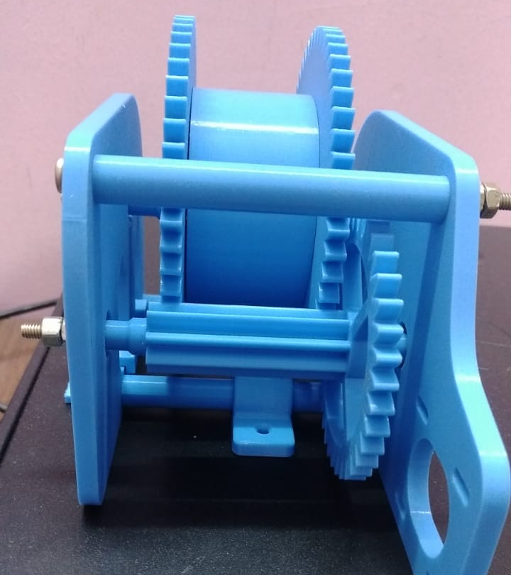
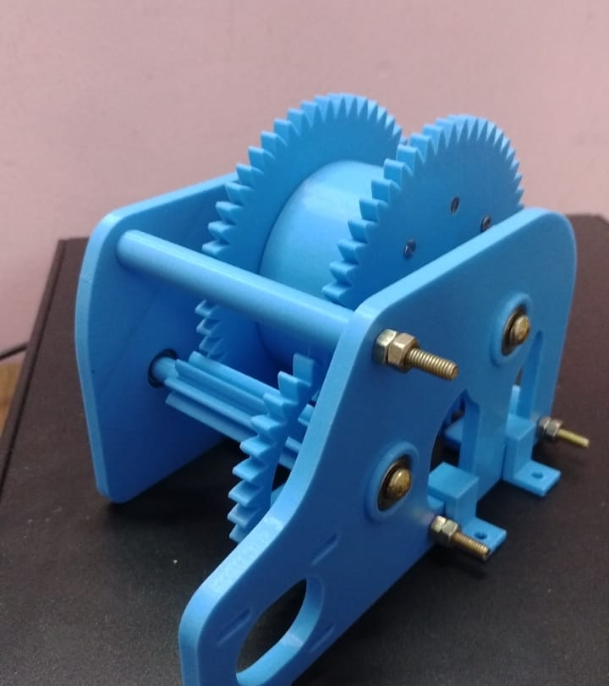
ASSEMBELY OF GEAR TRACTION

Slide 7
PROBLEM
Around 100 million people worldwide need a prosthetic limb to replace an amputated arm or leg, or an orthotic device to support a damaged limb. Yet it's estimated around 80 per cent of these people don't have access to these services – and this is a particular issue for low- and middle-income countries.

Slide 8
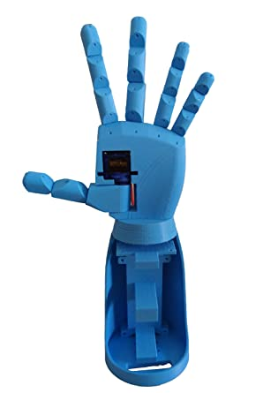
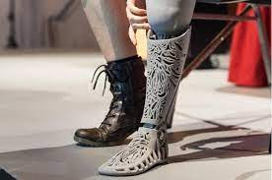
3D PRINTED PROSTHETIC BODY PARTS

Slide 9
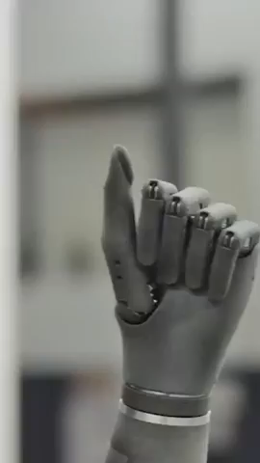

Slide 10
CIVIL INDUSTRY
A 3D printed house can be finished in as little as 24 hours if you want to talk about something more suitable for long-term habitation. Naturally, more complicated builds take longer. A new home can be printed in roughly 10 days using alternate, native materials that require additional processing.

Slide 11
SELLING OF 3D PRINTED PROSTHETIC HAND
PET FILAMENT SELLING PRICE
PRODUCTION COST 80 RS
(6.67 YUAN)
SELLING PRICE 1000 RS
(83.34 YUAN)
PLA,ABS FILAMENT SELLING PRICE
PRODUCTION COST 1200 RS
(100 YUAN)
SELLING PRICE 6000 RS
(500 YUAN)

Slide 12
Thank You

